Slide 1
Heroku Eye for the Windows Guy
Brandon Satrom
@BrandonSatrom
UserInExperience.com

Slide 2
Or…
4 Tips for Super-Charging Heroku and Ruby on Windows
Notes:
I’m a big fan of alternate titles in presentations and screencasts, so here’s another.

Slide 3
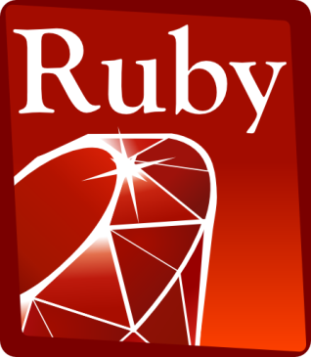

+
= Crazy Delicious
Notes:
If you’re watching this screencast, chances are you already know about or use Ruby, and you know how fun it is to use. Perhaps you’ve also heard about Heroku, a developer-focused cloud application platform that’s second-to-none. Together, Ruby and Heroku make for an awesome development and deployment experience.

Slide 4

“git push heroku master”
Notes:
My first experience with Heroku was through a rails tutorial book. In the first chapter of this book, the author introduced Heroku. Mere minutes after creating a basic Rails application, I was deploying that app to the Cloud with a single command. And it just worked.
Heroku is a polyglot platform, so there’s more to using the platform than just Ruby. Heroku also supports Node, Scala, Java and several other languages.

Slide 5
Using Heroku and Ruby on Windows Has a Few Pitfalls
Notes:
But I’m a Windows User, and using Heroku and Ruby on Windows isn’t quite a straightforward as using it on a Mac or Linux. If you follow any of the online tutorials, it can be quite jarring to hit a snag as you’re trucking along.

Slide 6


Windows Devs are People, Too
Just Suck it up and Buy a Mac!
Notes:
And I suppose it would be easy to say that Windows devs need to just buy a Mac, but that’s not an option for every dev. Some don’t want to buy a Mac, others cannot for one reason or another.
The good news is that Heroku cares about making the Windows experience better, and if you know where to look, you can get from zero to running a Heroku app on Windows in mere minutes.

Slide 7
4 Tips to Make it Better
Heroku Toolbelt is your Co-Pilot
Upgrade Your Console
Get A Great Text Editor
Git Bash FTW!
Notes:
Of course, getting up and running with Ruby and Heroku can be worlds easier if you just follow a few simple steps. The first is to install the Heroku Toolbelt for Windows, which gives you the Windows-specific tools you need to get going. Next, you should upgrade your console from cmd.exe to something snappier. I’d also suggest getting a good Ruby-friendly text editor like e or Vim. Finally, take 15 minutes to learn Git Bash, and learn to love the command line. It will make your Ruby and Heroku experience so much better.

Slide 8
Up and Running in Minutes
Demo Time!
Notes:
I’ll cover each of these items as I walk through going from zero to running on Heroku in just a few minutes. Let’s take a look now.

Slide 9
Resources
http://bit.ly/heroku_windows
Notes:
I hope this screencast has been helpful. For more information about the steps I’ve taken, I’ve put a Delicious link stack together at the link here. You can also find the same project I created and deployed to Heroku for this screencast, so if you’re having any issues getting running, feel free to clone that repo and compare to what you have.

Slide 10
Thank You, and Happy Heroku-ing
@BrandonSatrom
github.com/bsatrom
UserInExperience.com

